Slide 1
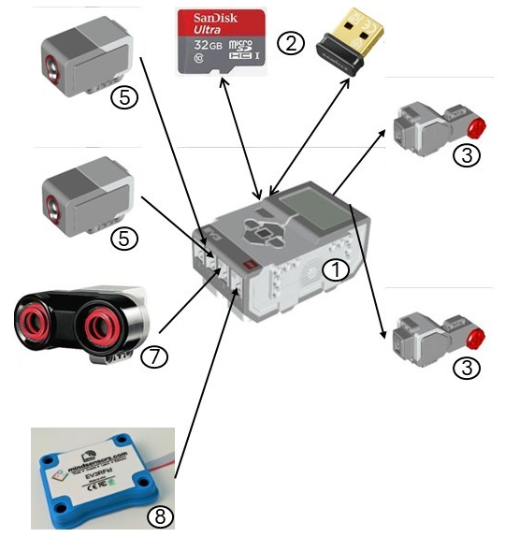
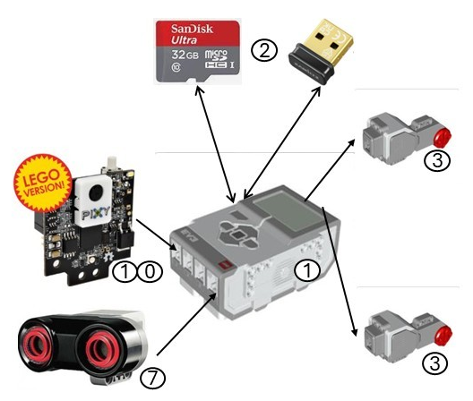

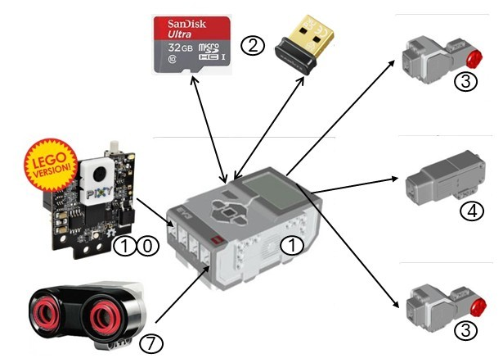
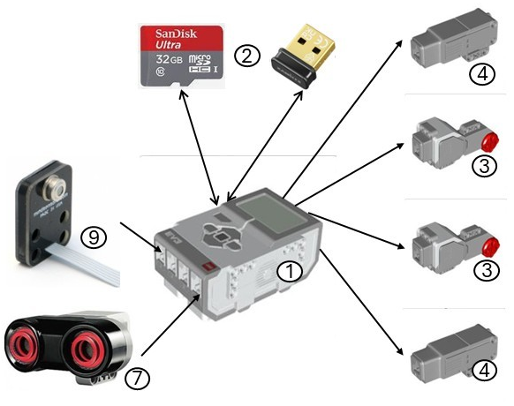
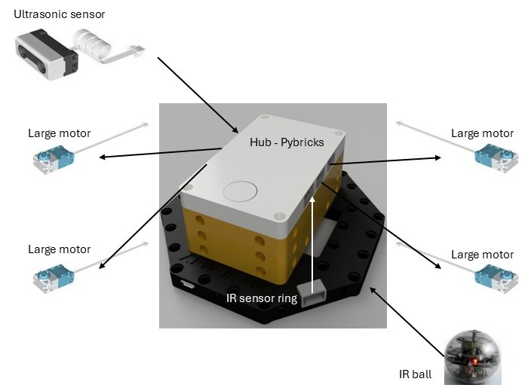
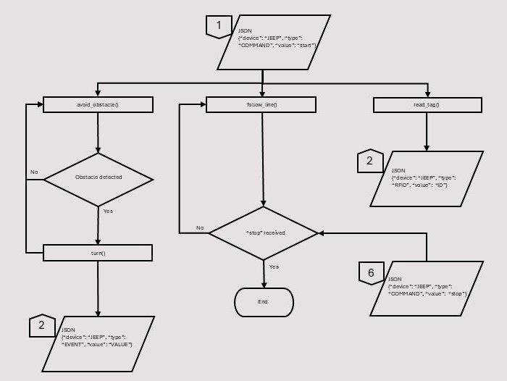
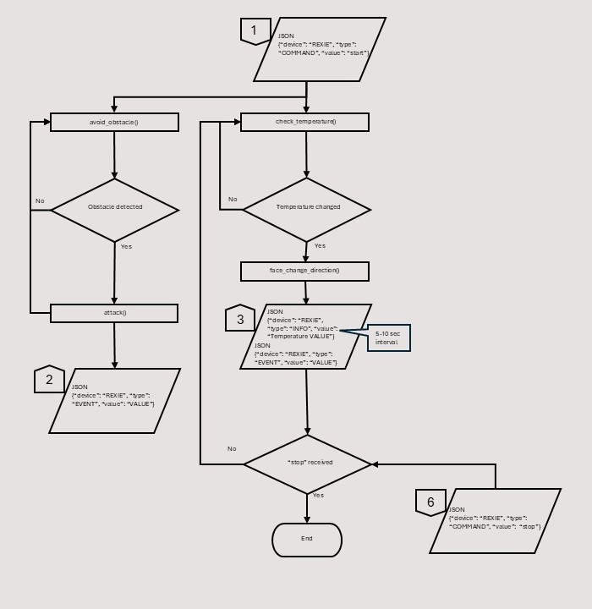

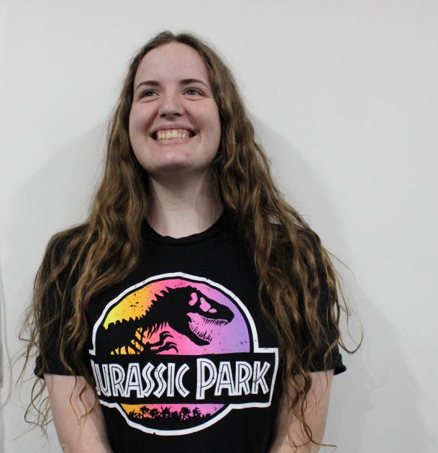
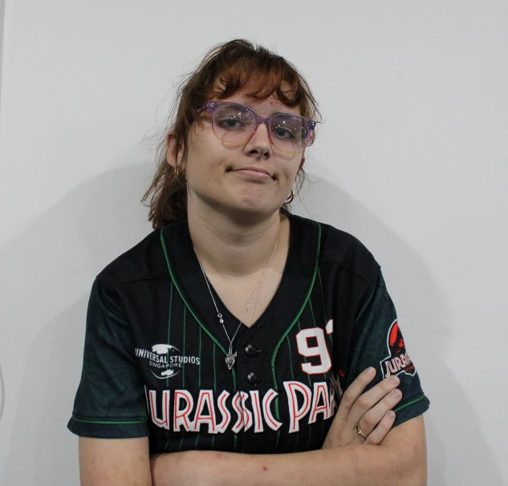
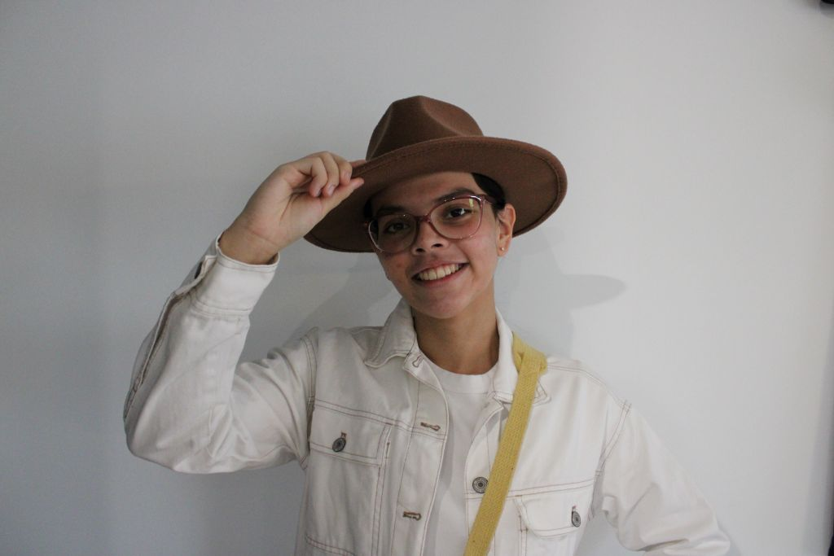
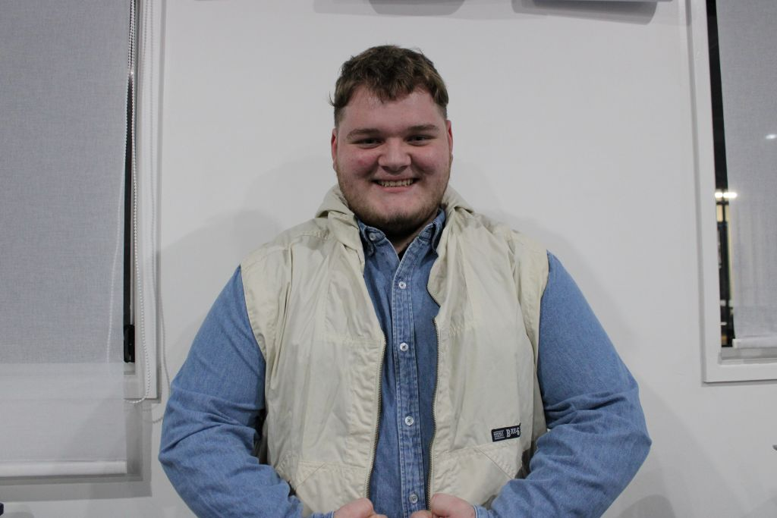
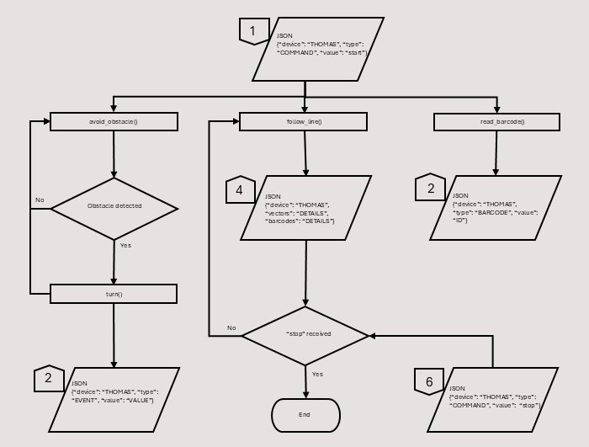
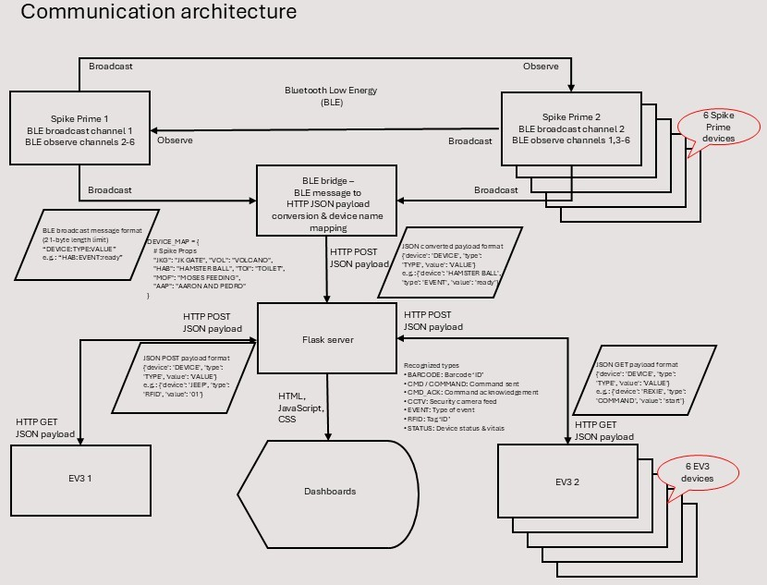




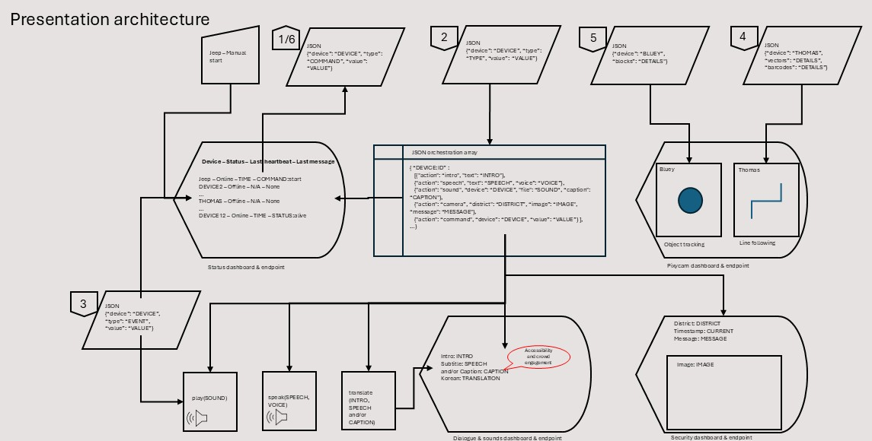
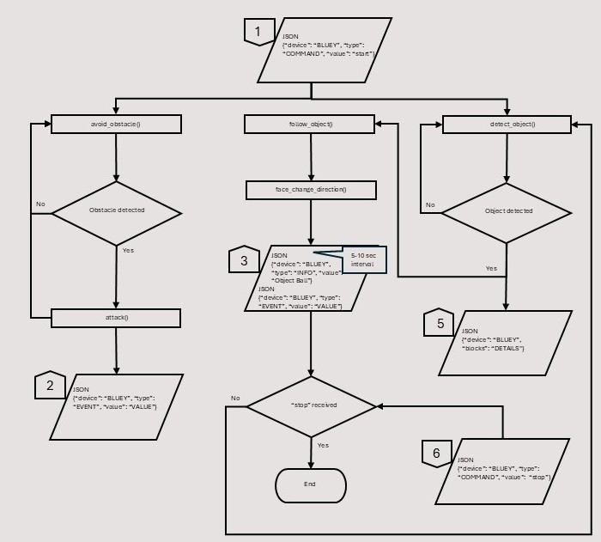
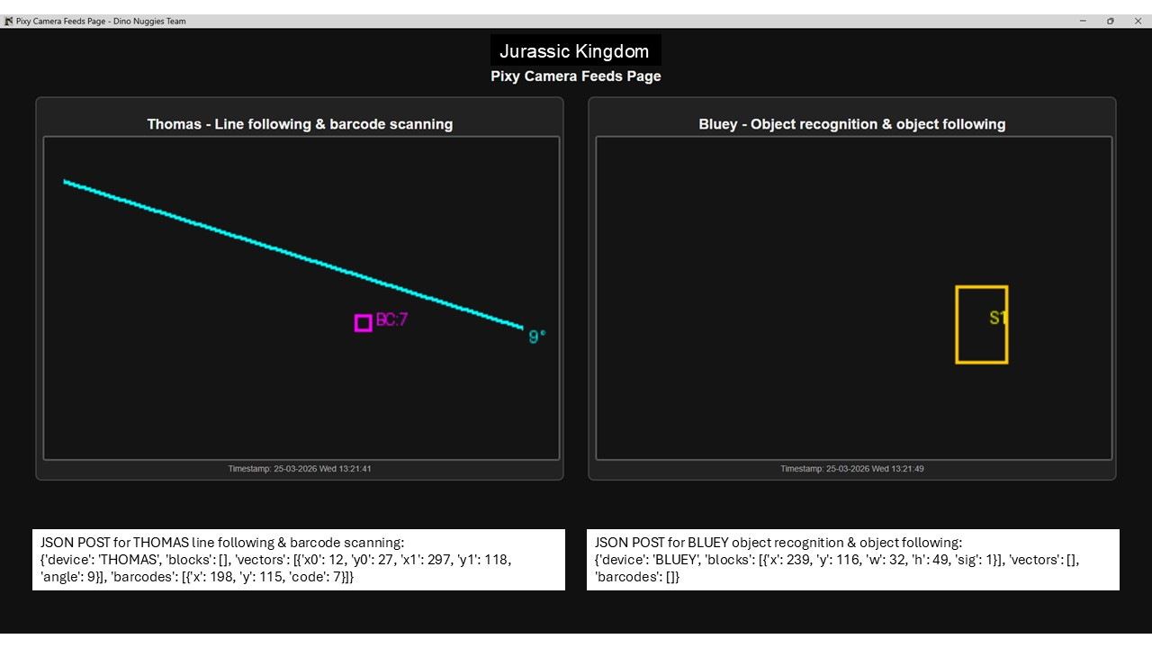
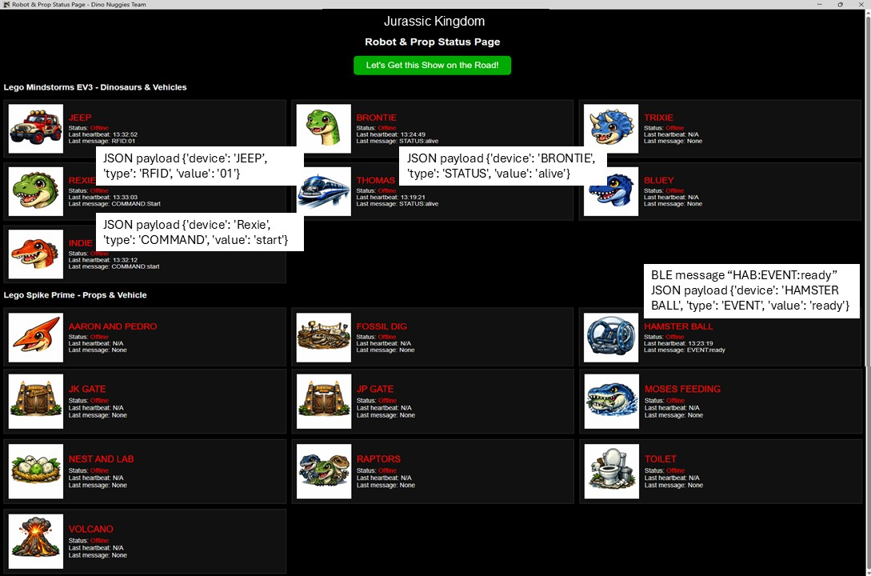
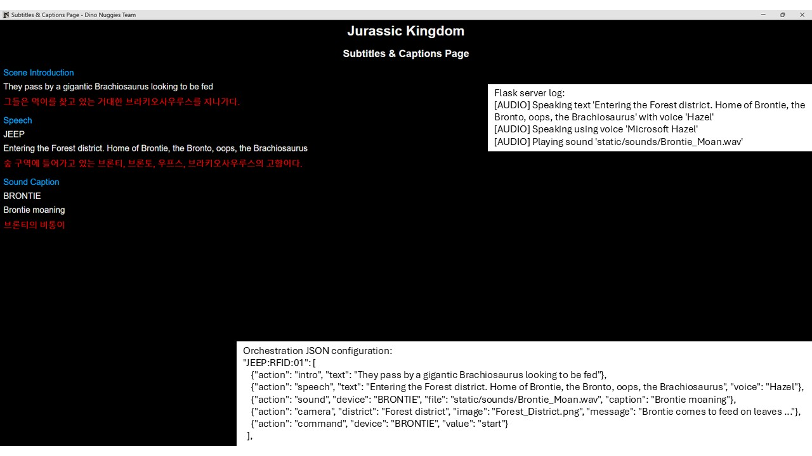
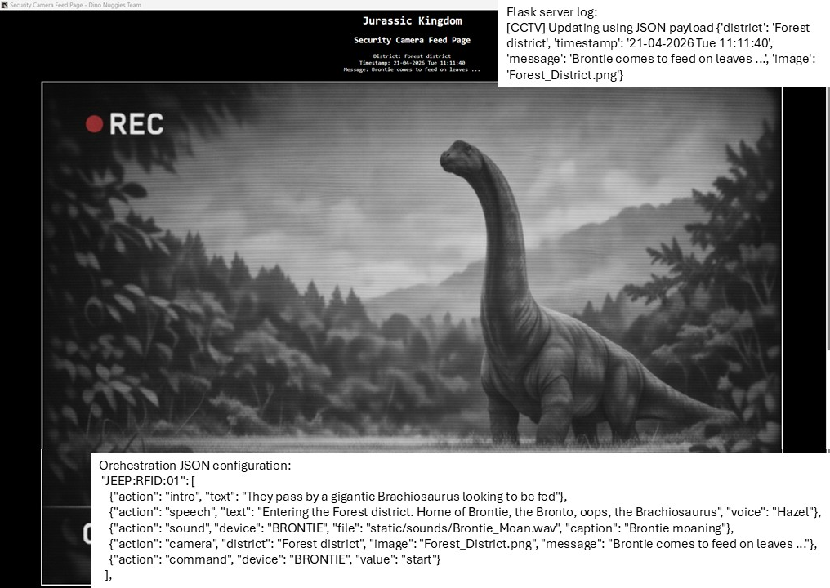
About the Dino Nuggies
We are 5 teenagers and young adults from Rockhampton QLD and Tamworth NSW Australia, all alumni or former students at Lighthouse Christian School. We competed in RoboCup Junior On Stage for 2 years and, in 2025, we won the Regional, State and National titles with a Jurassic Park theme. Our school is relatively small, and we did not have access to the technologies other teams may enjoy. We thus concentrated on improving on the existing build and add to it (four new robots and four new props) while considering sustainability and focusing on device communication using Flask.
Meet the ‘New’ Robot Crew
EV Threes – EVThreeDEV OS
Jeep - the Jeep is one of the Jurassic Kingdom orchestrators (see feature 4). It uses a radio frequency identification (RFID) reader for tag scanning (see feature 1) and an ultrasonic sensor for object avoidance
Rexie - the T-Rex uses a heat [Infrared (IR) temperature (non-contact)] sensor for object following (see feature 2) and an ultrasonic sensor for object ‘collision’
Thomas - the Monorail is the other Jurassic Kingdom orchestrator (see feature 4). It uses a video camera (PixyCam V2) for line following and barcode scanning (see feature 3) and an ultrasonic sensor for object avoidance
Bluey - the Raptor uses a PixyCam V2 for object recognition and following (see feature 3) and an ultrasonic sensor for object ‘collision’
SPIKE Prime - Pybricks Firmware
Hamster Ball - the Gyrosphere uses an IR sensor ring (ABW IR MK1) and IR ball (EK RCJ-05R) for object following and an ultrasonic sensor for object avoidance
Improved robot
Safety 2nd?
Safety 1st!
Even human-bonded?
Dinos do not care!
Glossary
Brick – EV3DEV Stretch OS (version 2020-04-10)
Edimax V2 Wi-Fi dongle (8188eu driver) and Sandisk 32 Gb SD card
Large motor (lego-ev3-l-motor class)
Small motor (lego-ev3-m-motor class)
Colour sensor (lego-ev3-color class)
Touch sensor (lego-ev3-touch class)
Ultrasonic sensor (lego-ev3-us class)
Mindsensors RFID reader (EV3Rfid ID‑12 / ID‑12LA chip)
Mindsensors IR temperature (non-contact) sensor (Melexis MLX90614 chip)
PixyCam V2 video camera (NXP LPC4330 chip)
Gyro sensor (lego-ev3-gyro class)
IR beacon (lego-ev3-ir class)
IR sensor (lego-ev3-ir class)
Mindsensors motor multiplexer (NXTMMX-v2 Atmel ATmega chip)
Safety 3rd?
  Meet the Team
  Abigail ‘the mad scientist’ Braun - Python developer
  Allira ‘the tourist’ Fleming -
  Poster & video designer, Jack of all trades
  Emily ‘the other tourist’ Scofield -
  Robot & prop costumer
  Madeleine ‘the guide’ Van Mello - Flask & Web developer, hardware coordinator
  Dustin ‘Grady Owen’ Ward -
  Robot & prop builder
SLIDE 5 GOES HERE
SLIDE 7 GOES HERE
Feature One - RFID Reader
Passive RFID system
Reader sends signal to tag using antenna (125 kHz electromagnetic field)
Tag e.g.: card, fob or sticker, receives signal and sends it back together with information stored in its memory (by taking some energy from the field)
Reader receives new signal and sends it to processor (in this case LEGO Mindstorms EV3 robot) for further handling
Sensor uses EV3RFid class in mindsensorsPYB library
Sensor communicates via the (Inter-Integrated Circuit) serial protocol with LEGO Mindstorms EV3 robot.
Feature Two - Heat Sensor
Heat sensor (non-contact infrared thermometer)
Able to return ambient temperature as well as temperature of any target it is pointing towards in both degrees Celsius and Fahrenheit
Field of view (FoV) of 70 degrees without collimator cap (fine for close objects) and 45 degrees with it (more accurate readings)
Sensor mode used e.g.: AMBIENT-C or TARGET-C but requires code to switch from one to other given robot only exposes one value per mode
Value to be divided by 100 to obtain actual readings.
A ‘roarsome’ Expedition
After their trip to Jurassic Park, which
ended in total disaster, the tourists now prepare for just another day on Isla Primis as they board the Jurassic Kingdom jeep with their guide, under the watchful eye of the park scientist. They enjoy feeding a Brachiosaurus and having a toilet break. But behold a T-Rex escapes and trashes the ... toilet. As they continue on their journey on the park monorail, they reach the coast and gasp at the Mosasaurus feeding. Sadly, now an Indominus Rex unleashes. Grady and his beloved Raptor manage to fend it off and he rolls away in his hamster ball. Is this the end? Surely not! The T-Rex joins in with the Raptor to chase the I-Rex away. It then gets mauled by another Mosasaurus, the Pterodactyl flies away and the volcano erupts...
Feature Three - Video Camera
Pixy2 camera
Communicates via I2C (Inter-Integrated Circuit) serial protocol with LEGO Mindstorms EV3 robot
Uses pixycamev3.pixy2 Python 3 library
Transfers JSON data, not video output, translated into images by Flask server
Images updated at small time intervals which gives impression of streaming
Uses line tracking/following algorithms to detect lines, intersections and small barcodes, intended for line-following robots
Presents on 'Pixy Camera Feeds Page' in Thomas pane
Data consists of vectors and barcodes. Vectors have X and Y start (i.e.: x0 and y0) and end (i.e.: x1 and y1) coordinates, and an angle. Barcodes have X and Y coordinates and a value
Uses tracking algorithms for colour-based object detection
Presents on 'Pixy Camera Feeds Page' in Bluey pane.
Data consists of blocks which have X and Y coordinate, width, height, and a signature.
Feature Four - Flask Server
Communication
  Hypertext Transfer Protocol (HTTP) communication with EV3s over Wi-Fi local area network (WLAN) in both directions i.e.: GET (receive data from Flask) and POST (send data to Flask)
  Bluetooth Low Energy (BLE) communication via BLE bridge with SPIKE Primes in one direction i.e.: POST
  BLE communication between SPIKE Primes in both directions i.e.: broadcast on one channel (send data) and observe on complementary channels (receive data).
Presentation via dashboards developed in Hypertext Markup Language (HTML), JavaScript and Cascading Style Sheets (CSS) displaying data sent to Flask server
    Instructions to start, perform routines and stop devices as defined in JavaScript Object Notation (JSON) orchestration file where applicable
    Device ‘vitals’ e.g.: temperature, speed
    Device speech and sounds with captions and offline translation to Korean (using NLLB-200 machine translation model)
    Object recognition shape and movement
    Line following vectors and barcode data
    ‘Security camera’ feed.
Links
Website & ‘doco’
FaceBook
Sustainability
Reusable materials
Robot and prop frames - Stock LEGO Technic, Mindstorms EV3 and Spike Prime
Floor mats – Usable on verso or anew on recto when primed
Floor mat tubing – Reusable until degraded, then recyclable
Team costumes – Retail stock
Transport cases - Heavy duty cases
Recyclable materials
Robot and prop costumes - Reused from local competitions and improved, made of carton, cloth, mesh and recyclable wood
3D-printed logos - Recyclable at Infilament
Recycled materials
Transport case foam – Retrieved from beds and sofas
Such fun!
GoFundMe
YouTube
Sponsors and Supporters
4RO
Central State Signs
CQ University
Girl Guides Rockhampton
Lighthouse Christian School
Michelle Landry MP
Millennium Collectables & Comics
Mr V STEAM with Bricks
Nigel Hutton MP
North Rockhampton Rotary Club
Nyree Johnson
STEM Changemakers
STEM Hub Rockhampton
Totally Toys
UpCycle CQ
Accessibility and crowd engagement
No custom printed circuit board (PCB) or fabricated part used

