Slide 1

Python Flask Framework Implementation in a Mixed LEGOTM Mindstorms EVThreeTM and LEGO SPIKE PrimeTM Hardware Architecture
for Dinosaurs in Flask:
aRoarsomeExpedition()
Madeleine Van Mello¹
¹ Team Dino Nuggies, Lighthouse Christian School,
Norman Gardens, QLD, Australia

Slide 2


Agenda
Introduction
Process
Communication
Presentation
Artificial intelligence
Reflection and conclusion
Questions
References
Presentation
Website & doco

Slide 3
Introduction
Performance by Team Dino Nuggies based on Jurassic Park© movie franchise
Implementation of Python Flask framework in a mixed LEGO Mindstorms EV3 and SPIKE Prime architecture
Hardware
  Laptop
  Wi-Fi hotspot or Wi-Fi mobile router
  Six LEGO Mindstorms EV3 robots
  Six LEGO SPIKE Prime robot and props.
Software
  EV3DEV Python or Pybricks MicroPython on LEGO Mindstorms EV3s
  EV3DEV Stretch (Debian Linux-based operating system)
  Pybricks on LEGO SPIKE Primes running Pybricks firmware
  Python 3.12 and JavaScript Object Notation (JSON) on laptop.

Slide 4
Introduction - Continued
Data exchange between devices, i.e., robot and props
  Using JSON packets sent via Hypertext Transfer Protocol (HTTP) GET and POST methods.
Hardware constraints
  No full two-way communication between LEGO Mindstorms EV3s and LEGO SPIKE Primes
  Alleviated by changes in JSON orchestration which drives communication and presentation.

Slide 5
Process
Flask server
  Set up using Flask Python Web application framework and corresponding ‘flask’ library
  Running from local machine, i.e., laptop, serving as Wi-Fi hotspot or connected to Wi-Fi router, to set up local network
  No requirement for Internet access even for translation from English to Korean.
Main Python program
  Opening four MS-Edge windows in which four dashboards/pages are displayed
  Importing all 'endpoints' (meaningful Universal Resource Locators [URLs] for both devices and users) which receive data from robots and props
  Sending data to robots
  Registering them as 'blueprints’
  Importing tools run in their own asynchronous processes.

Slide 6
Process - Continued
LEGO SPIKE Prime robots and props
  Sending data to
  Receiving data from each other as well, but not through Flask server.
Design choice due to
  Complexity of implementing full-blown Bluetooth communication architecture
  Shortcomings of Bluetooth implementation in EV3DEV Stretch operating system installed on LEGO Mindstorms EV3 robots.

Slide 7
Communication
Hypertext Transfer Protocol (HTTP)
  Allowing communication with LEGO Mindstorms EV3s over Wi-Fi local area network (WLAN) in both directions i.e.,
    GET (receive data from the Flask server)
    POST (send data to the Flask server).
Bluetooth Low Energy (BLE)
  Allowing communication via a BLE bridge with LEGO SPIKE Primes in one direction only, i.e., POST
BLE communication between LEGO SPIKE Primes
  Occurring in both directions, i.e.,
    Broadcast on one channel (send data)
    Observe on complementary channels (receive data).

Slide 8
Communication - Continued
Due to limitations in length of message strings, i.e., 21 usable characters
  Device map set up, e.g., JKG is 'Jurassic Kingdom Gate’
  Abbreviations then mapped back to full name via 'global state' Python file.

Slide 9
Communication - Architecture
Broadcast
Observe
Bluetooth Low Energy
(BLE)
Spike Prime 1
BLE broadcast channel 1
BLE observe channels 2-6
Spike Prime 2
BLE broadcast channel 2
BLE observe channels 1,3-6
6 Spike Prime devices
Observe
Broadcast
Broadcast
BLE bridge –
BLE message to
HTTP JSON payload conversion & device name mapping
Broadcast
BLE broadcast message format
(21-byte length limit)
“DEVICE:TYPE:VALUE”
e.g.: “HAB:EVENT:ready”
DEVICE_MAP = {
# Spike Props
"JKG": "JK GATE", "VOL": "VOLCANO",
"HAB": "HAMSTER BALL", "TOI": "TOILET",
"MOF": "MOSES FEEDING",
"AAP": "AARON AND PEDRO"
}
HTTP POST JSON payload
JSON converted payload format
{'device': 'DEVICE', 'type': 'TYPE', 'value': 'VALUE'}
e.g.: {'device': 'HAMSTER BALL', 'type': 'EVENT', 'value': 'ready'}
HTTP POST JSON payload
HTTP POST JSON payload
Flask server
JSON POST payload format
{'device': 'DEVICE', 'type': 'TYPE', 'value': 'VALUE'}
e.g.: {'device': 'JEEP', 'type': 'RFID', 'value’: '01'}
Recognized types
BARCODE: Barcode ‘ID’
CMD / COMMAND: Command sent
CMD_ACK: Command acknowledgement
CCTV: Security camera feed
EVENT: Type of event
RFID: Tag ‘ID’
STATUS: Device status & vitals
JSON GET payload format
{'device': 'DEVICE', 'type': 'TYPE', 'value': 'VALUE'}
e.g.: {'device': 'REXIE', 'type': 'COMMAND', 'value': 'start'}
HTML,
JavaScript,
CSS
HTTP GET JSON payload
HTTP GET JSON payload
EV3 1
6 EV3 devices
Dashboards
EV3 2

Slide 10
Presentation
Presentation occurs via dashboards developed in
  Hypertext Markup Language (HTML)
  JavaScript
  Cascading Style Sheets (CSS)
  Displaying data sent to Flask server.
Information displayed includes
  Device status
  Subtitles and captions
  Pixy camera feeds
  Security camera feed.

Slide 11
Presentation - Architecture
1/6
2
JSON
{“device”: “DEVICE”, “type”:
“TYPE”, “value”: “VALUE”}
5
4
Jeep – Manual start
JSON
{“device”: “DEVICE”, “type”:
“COMMAND”, “value”:
“VALUE”}
JSON
{“device”: “BLUEY”,
“blocks”: “DETAILS"}
JSON
{“device”: “THOMAS”,
“vectors”: “DETAILS”,
“barcodes”: “DETAILS”}
Device – Status – Last heartbeat – Last message
JSON orchestration array
{ “DEVICE:ID” :
[{"action": “intro", "text": “INTRO"},
{"action": "speech", "text": “SPEECH”, “voice”: “VOICE”},
{"action": "sound", “device”: “DEVICE”, "file": “SOUND“, “caption": “CAPTION"},
{"action": “camera”, “district": “DISTRICT”, “image”: “IMAGE", “message": “MESSAGE"},
{"action": “command", “device”: “DEVICE”, “value”: “VALUE”} ],
…}
Bluey
Thomas
Jeep – Online – TIME – COMMAND:start
DEVICE2 – Offline – N/A – None
…
THOMAS – Offline – N/A – None
…
DEVICE12 – Online – TIME – STATUS:alive
Object tracking
Line following
Status dashboard & endpoint
Pixycam dashboard & endpoint
3
JSON
{“device”: “DEVICE”,
“type”: “EVENT”,
“value”: “VALUE”}
District: DISTRICT
Timestamp: CURRENT
Message: MESSAGE
Accessibility and crowd engagement
Intro: INTRO
Subtitle: SPEECH
and/or Caption: CAPTION
Korean: TRANSLATION
Image: IMAGE
play(SOUND)
speak(SPEECH, VOICE)
translate
(INTRO, SPEECH and/or CAPTION)
Dialogue & sounds dashboard & endpoint
Security dashboard & endpoint

Slide 12
Presentation - Device Status
Instructions to start, perform routines and stop devices
  Defined in JSON orchestration file where applicable
Device ‘vitals’ e.g., temperature, speed, etc., sent to Flask server in JSON format
Temperature values obtained from ‘heat’ sensor (non-contact infrared thermometer)
All pieces of data
  Formatted in human-readable version
  Displayed on 'Robots & Props Status Page' .

Slide 13
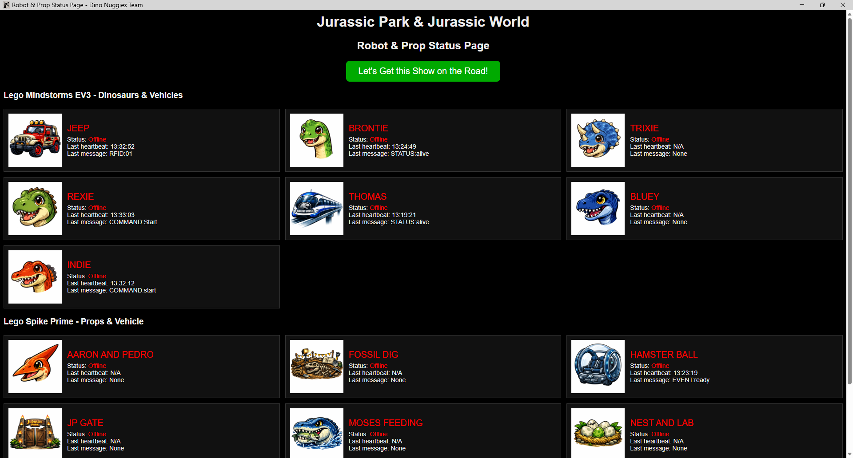
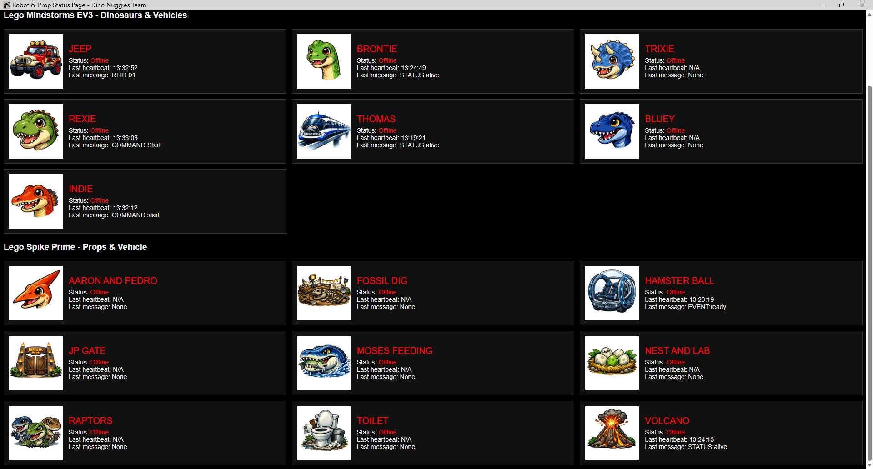
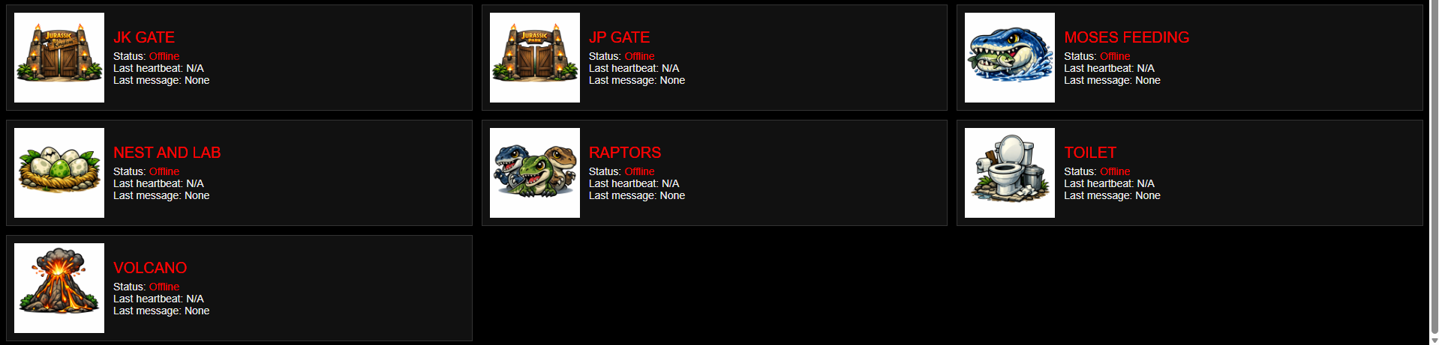
Jurassic Kingdom
JSON payload {'device': 'JEEP’, 'type’: 'RFID', 'value': '01'}
JSON payload {'device': 'BRONTIE', 'type': 'STATUS', 'value': 'alive'}
JSON payload {'device': 'Rexie', 'type': 'COMMAND', 'value': 'start'}
BLE message “HAB:EVENT:ready”
JSON payload {'device': 'HAMSTER BALL', 'type': 'EVENT', 'value': 'ready'}

Slide 14
Presentation - Subtitles and Captions
Device speech and sounds
  provided with captions and offline translation to Korean (using the NLLB-200 Machine Translation Model [MTM])
  MTM selected given
    Runing offline, i.e., does not require Internet access
    Relatively small in size.
Multiple Windows OneCore voices used through installation of both US and UK language packs, i.e.,
  Jeep speaks as ‘Hazel’ with British accent
  Thomas speaks as ‘David’ with American accent.
Sounds output by Flask server through ‘ffplay’ application chosen due to ability to play both WAV and MP3 sound files
Pieces of data displayed on the 'Subtitles & Captions Page’
  Facilitating accessibility and crowd engagement
  Moving compute power from robots and props to Flask server
  Allowing them to perform more efficiently, especially when processing heavy routines such as self-balancing.

Slide 15
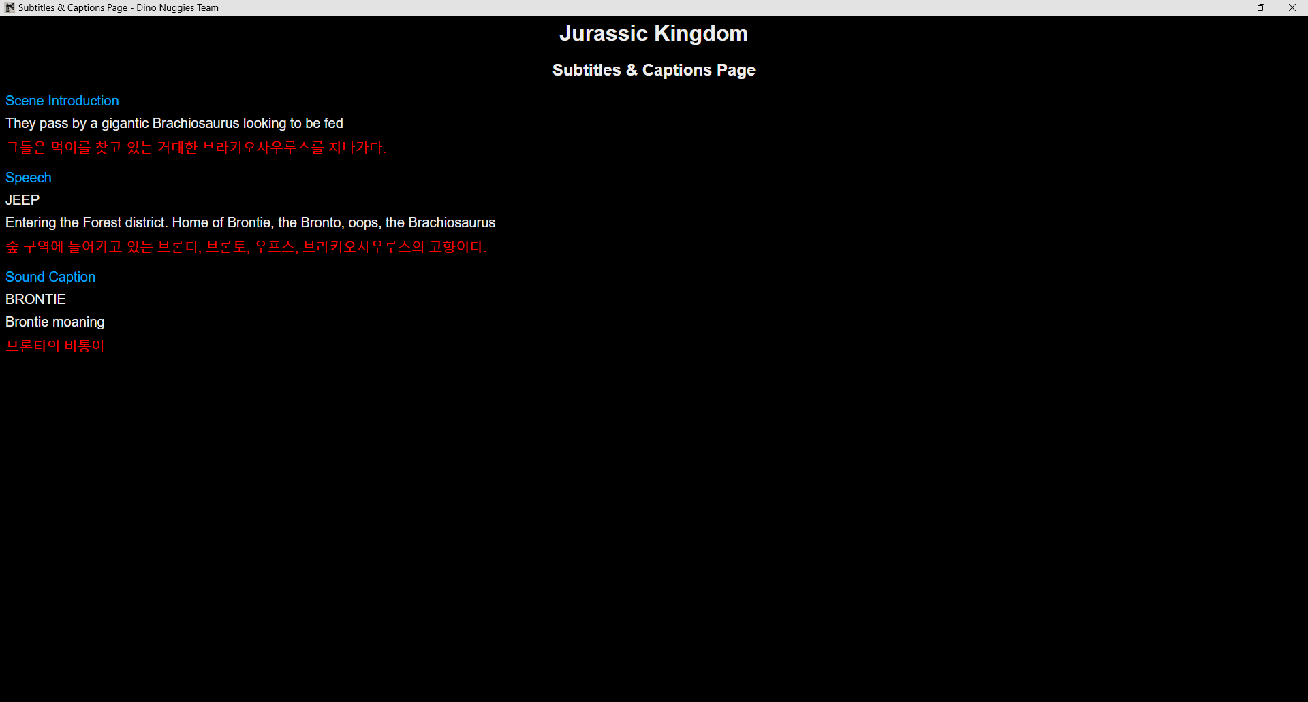
Flask server log:
[AUDIO] Speaking text 'Entering the Forest district. Home of Brontie, the Bronto, oops, the Brachiosaurus' with voice 'Hazel'
[AUDIO] Speaking using voice 'Microsoft Hazel'
[AUDIO] Playing sound 'static/sounds/Brontie_Moan.wav'
Orchestration JSON configuration:
"JEEP:RFID:01": [
{"action": "intro", "text": "They pass by a gigantic Brachiosaurus looking to be fed"},
{"action": "speech", "text": "Entering the Forest district. Home of Brontie, the Bronto, oops, the Brachiosaurus", "voice": "Hazel"},
{"action": "sound", "device": "BRONTIE", "file": "static/sounds/Brontie_Moan.wav", "caption": "Brontie moaning"},
{"action": "camera", "district": "Forest district", "image": "Forest_District.png", "message": "Brontie comes to feed on leaves ..."},
{"action": "command", "device": "BRONTIE", "value": "start"}
],

Slide 16
Presentation - Pixy Camera Feeds
Object recognition, shape and movement
  Used by one of LEGO Mindstorms EV3 robots to recognise a ball, follow it, and send JSON data to Flask Server
  Displayed in ‘Bluey’ pane of 'Pixy Camera Feeds Page’
  Consisting of blocks which have X and Y coordinate, width, height, and signature.
Line following vectors and barcode data
  Used by another LEGO Mindstorms EV3 robot to follow a line, detect barcodes, and send JSON data to Flask Server
  Displayed in ‘Thomas’ pane of 'Pixy Camera Feeds Page'
  Consisting of vectors and barcodes
    Vectors have X and Y start (i.e., x0 and y0) and end (i.e., x1 and y1) coordinates, and angle
    Barcodes have X and Y coordinates and value.

Slide 17
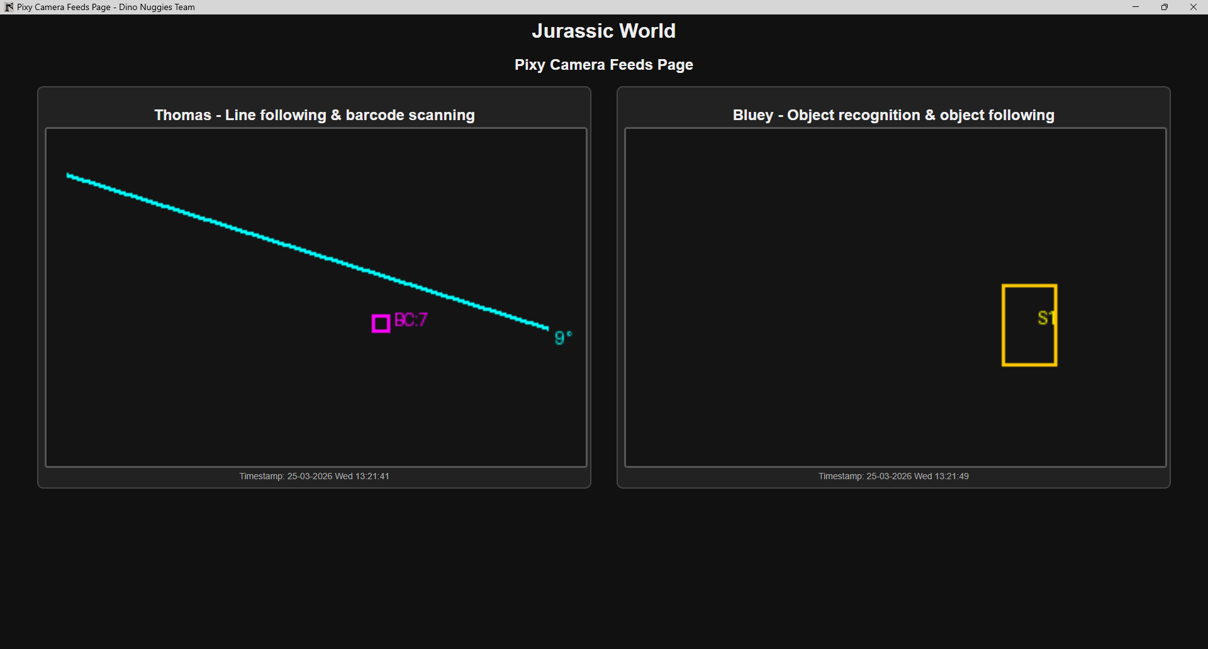
Jurassic Kingdom
JSON POST for THOMAS line following & barcode scanning:
{'device': 'THOMAS', 'blocks': [], 'vectors': [{'x0': 12, 'y0': 27, 'x1': 297, 'y1': 118, 'angle': 9}], 'barcodes': [{'x': 198, 'y': 115, 'code': 7}]}
JSON POST for BLUEY object recognition & object following:
{'device': 'BLUEY', 'blocks': [{'x': 239, 'y': 116, 'w': 32, 'h': 49, 'sig': 1}], 'vectors': [], 'barcodes': []}

Slide 18
Presentation - Security Camera Feed
‘Security camera’ feed
  Displayed on the 'Security Camera Feed Page’
  Information required
    Stored in JSON packet
    Comprising of
      Time stamp of message
      Content
      Image stored in Flask ‘static’ folder mimicking live security camera feed.

Slide 19
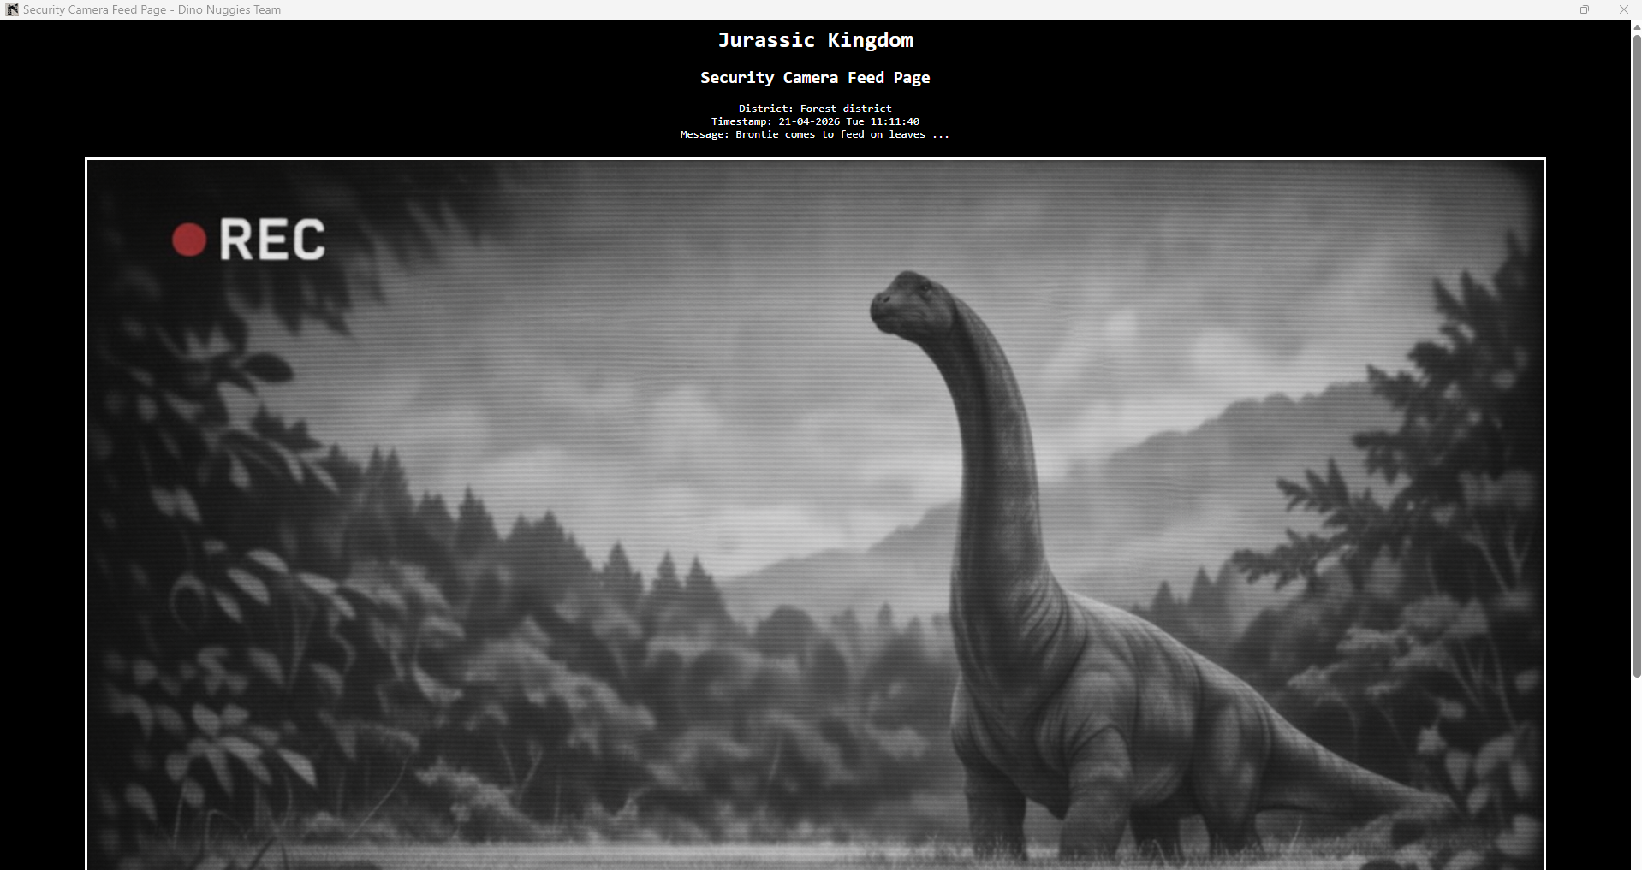

Flask server log:
[CCTV] Updating using JSON payload {'district': 'Forest district', 'timestamp': '21-04-2026 Tue 11:11:40', 'message': 'Brontie comes to feed on leaves ...', 'image': 'Forest_District.png'}
Orchestration JSON configuration:
"JEEP:RFID:01": [
{"action": "intro", "text": "They pass by a gigantic Brachiosaurus looking to be fed"},
{"action": "speech", "text": "Entering the Forest district. Home of Brontie, the Bronto, oops, the Brachiosaurus", "voice": "Hazel"},
{"action": "sound", "device": "BRONTIE", "file": "static/sounds/Brontie_Moan.wav", "caption": "Brontie moaning"},
{"action": "camera", "district": "Forest district", "image": "Forest_District.png", "message": "Brontie comes to feed on leaves ..."},
{"action": "command", "device": "BRONTIE", "value": "start"}
],

Slide 20
Artificial Intelligence
AI used extensively for development of
  Python code specific for LEGO Mindstorms EV3 and SPIKE Prime robots and props
  Python, HTML, JavaScript routines for Flask server and dashboards.
Due to
  Complexity of architecture combining Wi-Fi and Bluetooth communication between devices and Flask server
  Level of coding expertise required to
    Implement Flask server and dashboard landscape
    Allow Flask server to present data sent via JSON packets from LEGO Mindstorms EV3 and SPIKE Prime devices
    Display data on Pixy camera feeds
    Send data back to devices to perform routine synchronously with team members.
AI provides advice, not solutions
Prompts must be carefully phrased to ensure advice is relevant
Advice must be challenged based on previous responses.

Slide 21
Reflection and Conclusion
Complex LEGO EV3 and SPIKE Prime systems can be engineered into a coordinated, performance‑ready architecture
Integration of Wi‑Fi, BLE, JSON communication, and Flask dashboards required adaptation to hardware and communication constraints
Each challenge enhanced the design and deepened understanding of mixed‑technology orchestration
Collaboration among mentors, teammates, and supporters produced a system that was both technically robust and artistically engaging
The project illustrates what can be achieved through curiosity, discipline, and teamwork
The architecture supported a successful RoboCup Junior performance and provides a foundation for future teams
Lessons in communication design and system coordination will inform and inspire future engineering efforts.

Slide 22

Questions

Slide 23
References
Universal Parks & Resorts Vacations - Copyright & Trademark, https://vacations.universalstudioshollywood.com/
copyright-trademark, last accessed 2026/05/28
Welcome to Flask — Flask Documentation (3.1.x), https://flask.palletsprojects.com/en/stable/, last accessed 2026/05/28
ev3dev Home, https://www.ev3dev.org/, last accessed 2026/05/28
Pybricks Code, https://code.pybricks.com/, last accessed 2026/05/28
Werkzeug — Werkzeug Documentation (3.1.x), https://werkzeug.palletsprojects.com/en/stable/, last accessed 2026/05/28
Template Designer Documentation — Jinja Documentation (3.1.x), https://jinja.palletsprojects.com/en/stable/templates/, last accessed 2026/05/28
facebook/nllb-200-distilled-600M / Hugging Face, https://huggingface.co/facebook/nllb-200-distilled-600M, last accessed 2026/05/28
Flask server directory structure. https://lcs.ipto.com.au/Students/dinonuggies/images/documentation/flask_server.txt, last accessed 2026/05/28
Flask server code, https://lcs.ipto.com.au/Students/dinonuggies/images/documentation/flask_server.zip, last accessed 2026/05/28
Flask server communication architecture, https://lcs.ipto.com.au/Students/dinonuggies/images/features/flask2.jpg, last accessed 2026/05/28
Flask server presentation architecture, https://lcs.ipto.com.au/Students/dinonuggies/images/features/flask4.jpg, last accessed 2026/05/28
Feature One Page - Dino Nuggies Team, https://lcs.ipto.com.au/Students/dinonuggies/pages/feature1.html, last accessed 2026/05/28
Feature Three Page - Dino Nuggies Team, https://lcs.ipto.com.au/Students/dinonuggies/pages/feature3.html, last accessed 2026/05/28
Feature Two Page - Dino Nuggies Team, https://lcs.ipto.com.au/Students/dinonuggies/pages/feature2.html, last accessed 2026/05/28
Flask server dashboard – Device status page, https://lcs.ipto.com.au/Students/dinonuggies/images/features/flask5.jpg, last accessed 2026/05/28
Flask server dashboard – Subtitles and captions page, https://lcs.ipto.com.au/Students/dinonuggies/images/features/flask7.jpg, last accessed 2026/05/28
Flask server dashboard – Pixy camera feeds page, https://lcs.ipto.com.au/Students/dinonuggies/images/features/flask8.jpg, last accessed 2026/05/28
Flask server dashboard – Security camera feed page, https://lcs.ipto.com.au/Students/dinonuggies/images/features/flask6.jpg, last accessed 2026/05/28
ffplay Documentation, https://ffmpeg.org/ffplay.html, last accessed 2026/06/04

